Slide 1

Detection Of Soccer Ball In Match Videos
Department of Computer Science & Engineering, IIT Jodhpur
Anmol Chhabra (B15CS009)
Harshit Singh (B15CS019)
Mentor : Dr. Gaurav Harit
Assistant Professor
Department of Computer Science and Engineering
IIT Jodhpur

Slide 2
Problem statement
Detection of football using image processing techniques has become a crucial tool in analyzing the game and the performance of the players.
Detection of soccer ball is motivated by various applications such as event detection, tactics analysis, automatic summarization, etc.
The reason for not achieving satisfactory recognition is due to blurred frames and fast moving objects or due to intermixing of objects in frames which resemble the color as that of the soccer ball.

Slide 3
INPUT: A recorded soccer match video or a live video stream
and color limits of the ball in the particular video.
OUTPUT: A video with the detected Soccer ball with clear boundaries.
ASSUMPTIONS:
The color of the ball is assumed to be white for object identification.
The color of the jersies of the players are choosen in such a way that they don’t conflict with that of the soccer ball.
CONSTRAINTS:
The ball will not be detected accurately when the ball comes in the vicinity of the white boundary lines and the goal posts or if the shoes or the gloves of the players fall in the same color range as that gievn in input.
The frames in which the ball is being shot from a very large angle of view are ommitted as result due to blurring of the ball in those particular frames.

Slide 4
Description of Work Done
Color Detection-
The aim of color Detection is to seperate a particular object among all other objects on the basis of its color.
According to the assumptions made,white color is being distinguished from the other objects in the frame by setting certain range for white color.
The various techniques that have been employed to complete the objective are
Conversion of frames to HSV color space
Separation of white color with the help of mask

Slide 5


Result Of Color Identification-

Slide 6
Shape Identification
This technique is used to separate objects on the basis of shape from all other object in the frame.
The shape being identified is the primary shape of the soccer ball i.e the circle.
Techniques like Hough Transforms and contours detection are uused to identify the circles in the image

Slide 7

Results of Circle Detection-

Slide 8
Work Distribution
After finalizing the project, the work has been distributed among us in the following manner:
S. No. | Work | Done By
1. | Reading and understanding the document provided to us by our mentor | Both
2. | Getting familiar with the Python Environment (Anaconda Python 2.7) | Both
3. | Color Detection method and its implementation in image and videos | Both
4. | Circle Detection method and its implementation in image and videos. | Both
5. | Detection on the basis of combined methods of shape and color detection and finally highlighting the ball in image and videos. | Both

Slide 9
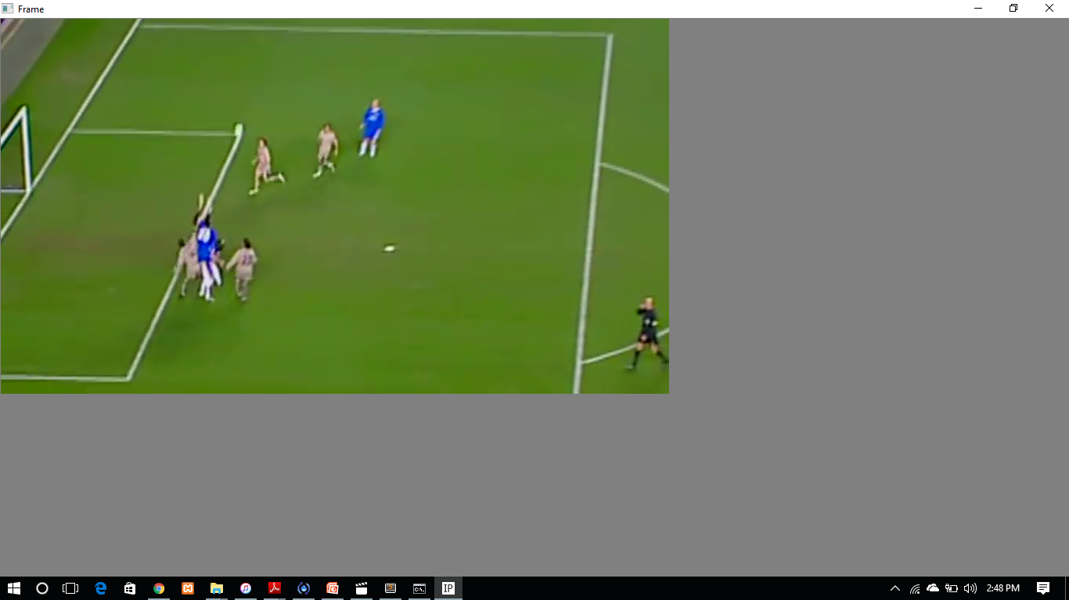
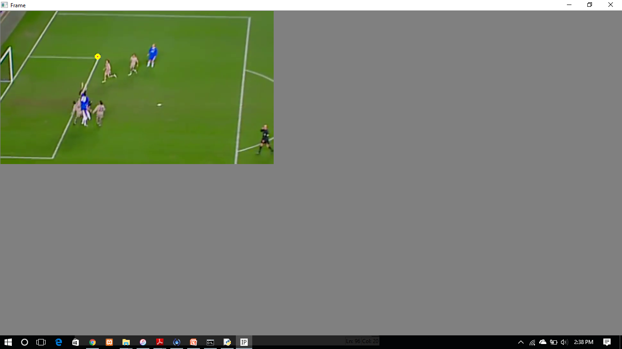
Screenshots of some frames-
Fig-1 Fig-2
Input video Output video with detected ball

Slide 10
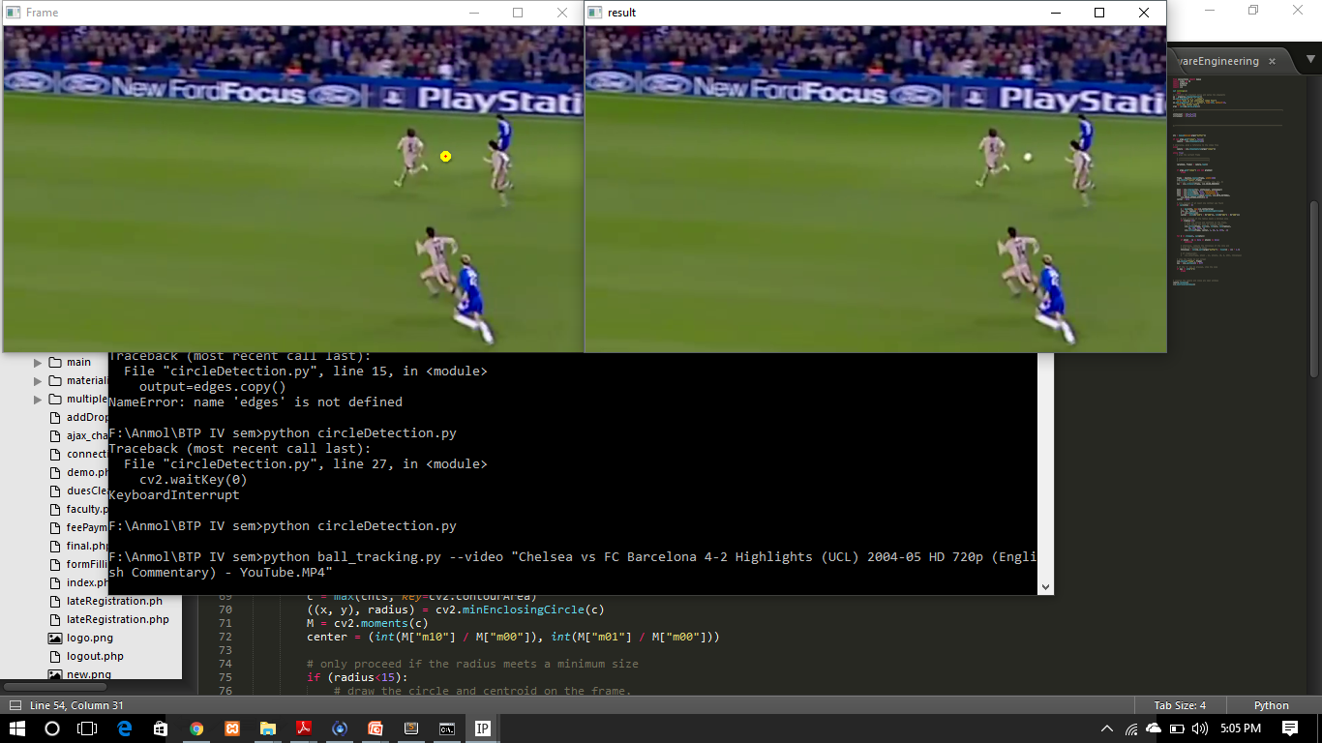
Screenshots of some frames-
Fig-1 Fig-2
Input video Output video with detected ball

Slide 11

Screenshots of some frames-
Fig-1 Fig-2
Input video Output video with No detected ball

Slide 12
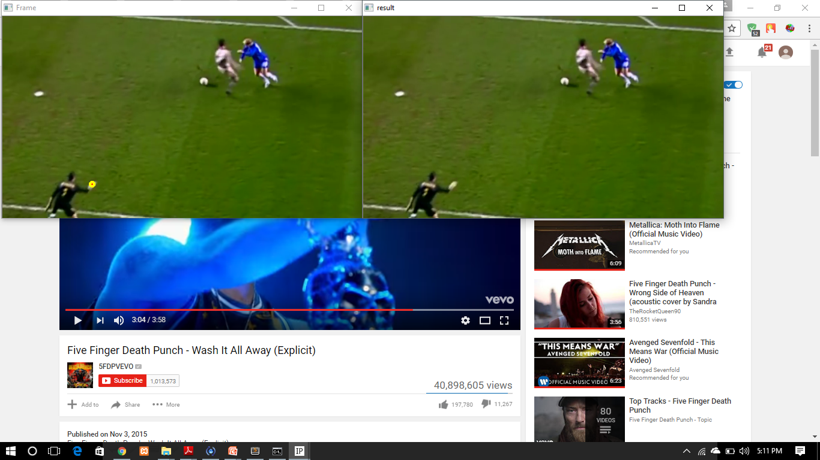
Screenshots of some frames-
Fig-1 Fig-2
Input video Output video with false detection (Goalkeeper’s glove is detected)

Slide 13
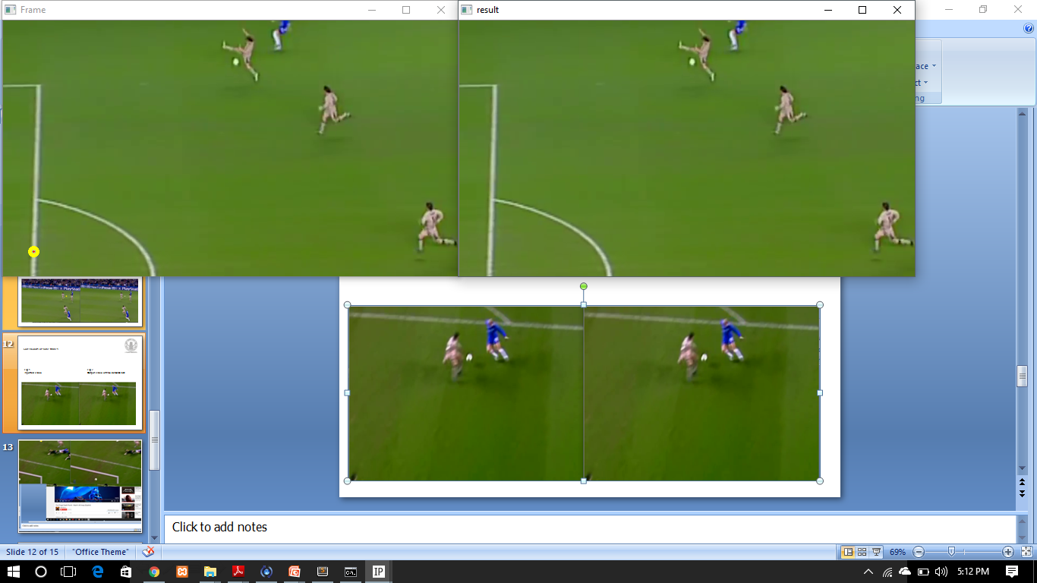
Screenshots of some frames-
Fig-1 Fig-2
Input video Output video with False detection

Slide 14
References
Basics of Image processing and opencv library-
https://www.youtube.com/playlist?list=PLQVvvaa0QuDffXBfcH9ZJuvctJV3OtB8A
https://www.youtube.com/watch?v=Z78zbnLlPUA&list=PLQVvvaa0QuDdttJXlLtAJxJetJcqmqlQq

Slide 15
Thank You
Presented By:
Anmol Chhabra (B15CS009)
Harshit Singh (B15CS019)

